Slide 1
Department of Computer Science
CS F364 – DESIGN AND ANALYSIS OF ALGORITHMS
LECTURE 4, 5
PORTIONS: As specified in handout and the contents taught in class. Class notes is must. Refer to the textbook as mentioned in handout
PLEASE NOTE THAT PPT IS JUST AN ADDITIONAL REFERENCE.

Slide 2
Topics- Lecture 1,2,3
LECTURE 4 | Max-Min problem, Explain merge sort – derive the recursion equation and complexity | 1. Refer R2: 3.4 2. Refer R2: 3.5, 3. Refer T1: 2.3
LECTURE 5 | Explain quick sort, selection sort - derive the recursion equation and complexity | 1. Refer R2: 3.6 2. Refer T1: Chapter: 7

Slide 3
Min-Max Problem
List List 1 List 2
n elements n/2 elements n/2 elements
min, max min1, max1 min2, max2
min = MIN ( min1, min2 )
max = MAX ( max1, max2)

Slide 4
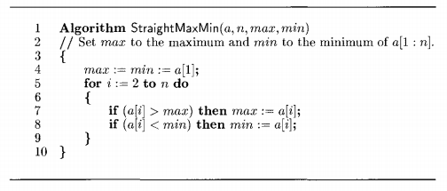
Min-Max Problem – Brute Force Approach
Key comparisons: 2(n – 1)

Slide 5
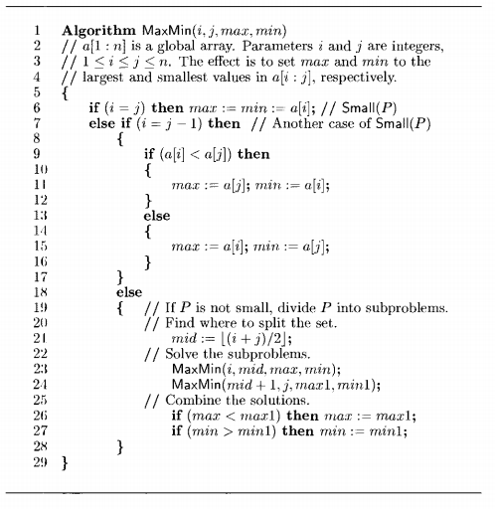
Min-Max Problem – D & C

Slide 6
Example: find max and min in the array:
22, 13, -5, -8, 15, 60, 17, 31, 47 ( n = 9 )
Index: 1 2 3 4 5 6 7 8 9
Array: 22 13 -5 -8 15 60 17 31 47
Rmaxmin(1, 9, 60, -8)
1, 5, 22, -8 6, 9, 60, 17
1, 3, 22, -5 4, 5, 15, -8 6,7, 60, 17 8, 9, 47, 31
1,2, 22, 13 3, 3,-5, -5
(1)
(6)
(2)
(5)
(7)
(8)
(3)
(4)

Slide 7
Analysis: For algorithm containing recursive calls, we can use recurrence relation to find its complexity
T(n) - # of comparisons needed for Rmaxmin
Recurrence relation:

Slide 8
Assume n = 2^{k} for some integer k
CHECK NOTES FOR COMPLEXITY ANALYSIS

Slide 9
Mergesort
Split array A[0..n-1] into about equal halves and make copies of each half in arrays B and C
Sort arrays B and C recursively
Merge sorted arrays B and C into array A as follows:
Repeat the following until no elements remain in one of the arrays:
compare the first elements in the remaining unprocessed portions of the arrays
copy the smaller of the two into A, while incrementing the index indicating the unprocessed portion of that array
Once all elements in one of the arrays are processed, copy the remaining unprocessed elements from the other array into A.

Slide 10
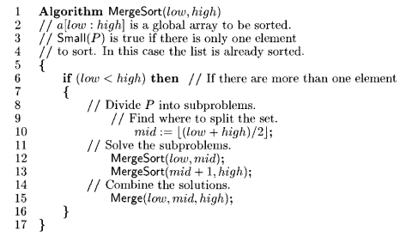
Pseudocode of Mergesort

Slide 11
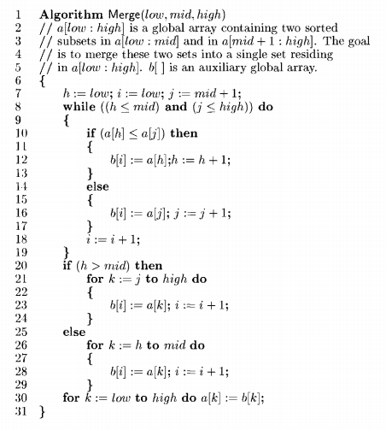
Pseudocode of Merge Sort

Slide 12
Mergesort Example
Notes:
Go over this example in detail, then do another example of merging, something like:
(1 2 5 7 9)
(3 4 6)

Slide 13
Analysis of Mergesort
T(n) = 2T(n/2) + Θ(n), T(1) = 0
All cases have same efficiency: Θ(n log n)
CHECK NOTES FOR COMPLEXITY ANALYSIS
Notes:
even if not analyzing in detail, show the recurrence for mergesort in worst case:
T(n) = 2 T(n/2) + (n-1)
worst case comparisons for merge

Slide 14
Merge Sort – Recurrence Relation
Def. T(n) = number of comparisons to mergesort an input of size n.
Mergesort recurrence.
Solution. T(n) = O(n log₂ n).

Slide 15
Proof by Recursion Tree – Merge Sort
T(n)
n
T(n/2)
T(n/2)
2(n/2)
T(n/4)
T(n/4)
T(n/4)
T(n/4)
4(n/4)
log₂n
. . .
T(n / 2^{k})
2^{k} (n / 2^{k})
. . .
T(2)
T(2)
T(2)
T(2)
T(2)
T(2)
T(2)
T(2)
n/2 (2)
n log₂n
15

Slide 16
Quicksort
Select a pivot (partitioning element) – here, the first element
Rearrange the list so that all the elements in the first s positions are smaller than or equal to the pivot and all the elements in the remaining n-s positions are larger than or equal to the pivot (see next slide for an algorithm)
Exchange the pivot with the last element in the first (i.e., ≤) subarray — the pivot is now in its final position
Sort the two subarrays recursively
p
A[i]≤p
A[i]≥p

Slide 17
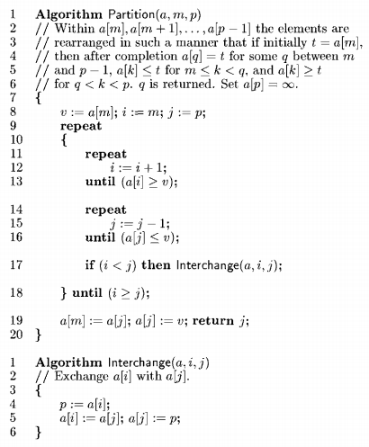
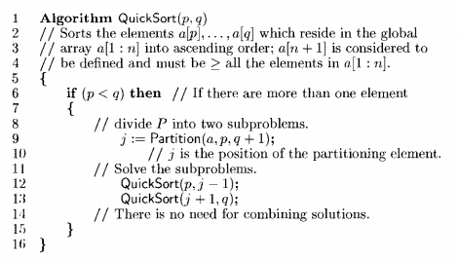
Partitioning Algorithm – Quick Sort
or i > r
or j = l
<

Slide 18
Analysis of Quicksort
Best case: split in the middle — Θ(n log n)
Worst case: sorted array! — Θ(n²)
Average case: random arrays — Θ(n log n)
Complexity derivation of quick sort
Improvements:
better pivot selection: median of three partitioning
switch to insertion sort on small subfiles
CHECK NOTES FOR COMPLEXITY ANALYSIS
T(n) = T(n-1) + Θ(n)

Slide 19
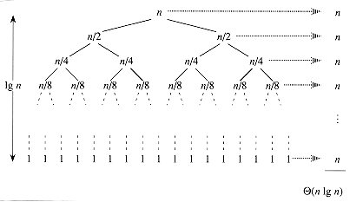
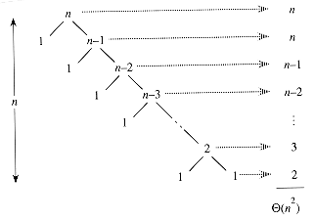
Quick sort Recursion tree

Slide 20
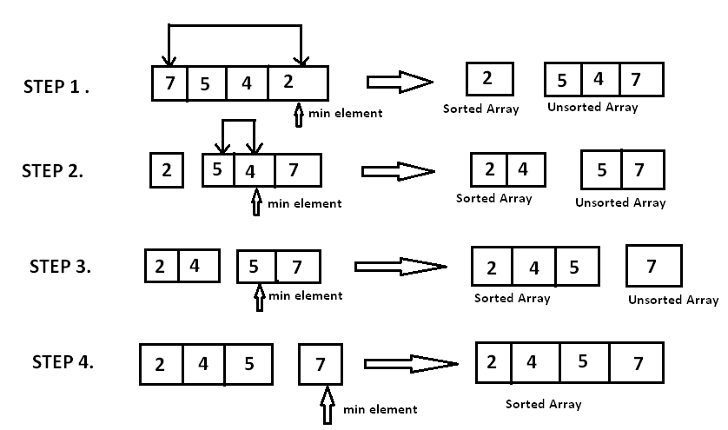
Selection Sort
In place sorting algorithm
selectionSort(int arr[], int i, int n)
{
int min = i;
for (int j = i + 1; j < n; j++)
{
if (arr[j] < arr[min])
min = j;
}
swap(arr, min, i);
if (i + 1 < n) {
selectionSort(arr, i + 1, n);
}
}
Try Selection Sort Analysis

Slide 21
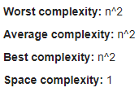

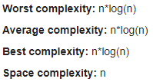
Selection Sort Quick Sort Merge Sort

Slide 22
Thank You

